Slide 1

2024-2025 FAFSA
What to Expect and How to Prepare
Student Financial Aid Services
Student Financial Aid Services
Notes:
1

Slide 2

Agenda
Simplified FAFSA
What is Not Changing
Tax Year Data & Deadlines
Six Things You Need Before Filing
FSA ID & Password
Student Aid Index (SAI)
Who is my Parent
Contributors
Consent & IRS Data
Refusal to Provide Consent
Technical Issues
Next Steps
Non-Federal Assistance
Resources
FAFSA Prototype
Important Information
Q&A
Student Financial Aid Services
Notes:
2

Slide 3
Simplified FAFSA
Congressional changes to improve financial aid
The 2024-2025 FAFSA (fafsa.gov) has a more streamlined user experience for students and parents
FAFSA expands eligibility for federal student aid
  Fewer questions 46 (down from 100)
  Pell Grant eligibility is tied to family size, Adjusted Gross Income (AGI), and poverty guidelines
  Family size is based on tax exemptions
    Students/Parents can update family size on the application
Student Financial Aid Services
Notes:
4

Slide 4
What is Not Changing
Student Eligibility
- Enrollment in an eligible degree/certificate program
- Citizenship (U.S. Citizen, Eligible Noncitizen)
- Enrollment – Full Time for TAG, Scholarships; Half Time for
Federal Direct Loans; Pell is based on enrollment
Student Responsibilities
- Respond to the Financial aid office and Higher Education Student
Assistance Authority (HESAA) requests promptly
- Document submission (Verification, Conflict resolution)
- Begin Enrollment (aid disbursed after student attendance is
confirmed)
- Maintain Satisfactory Academic Progress
Student Financial Aid Services
Notes:
2

Slide 5
Tax Year Data & Deadlines
FAFSA Release Date
  2024-2025 opened on December 31, 2023
2022 Federal Tax Information will be reported on the 2024-2025 FAFSA
NJIT’s Priority filing deadline is March 1, 2024
List a New Jersey school as the #1 choice on the FAFSA
NJ State Grant FAFSA filing deadline for renewal students is May 15th, 2024 (only applicable to 2024-2025). Generally, it is April 15th every year. See HESAA deadlines:
https://hesaa.org/Pages/StateDeadlinesNextAY.aspx
Student Financial Aid Services

Slide 6

Six Things You Need Before Filing Filing
FSA ID & Password
Contributor Information
2022 Federal Income Tax Return
Records of Untaxed Income
Records of Assets
List of Schools
Student Financial Aid Services

Slide 7
FSA ID & Password
Make sure you and your parents have a StudentAid.gov account and you remember your FSA ID & Password. Watch the video on creating an FSA ID. https://www.youtube.com/watch?v=Pitb_aIQBVc
Log into StudentAid.gov account and confirm your biographical
information, address and email is correct
Accessing the FAFSA (fafsa.gov)
  FSA ID is required for all contributors
  Users can no longer access the online FAFSA by providing personal identifiers (name, DOB, SSN) and a save key
  All biographical data is pulled from the FSA ID
Student Financial Aid Services
Notes:
2

Slide 8
Student Aid Index (SAI)
The Student Aid Index (SAI) is an eligibility index number that the financial aid office uses to determine how much federal student aid you would receive if you attended the school
This number results from the information that you provide on your FAFSA® form. This number is not a dollar amount of aid eligibility or what your family is expected to provide
Student Financial Aid Services
Notes:
4

Slide 9

Who is my Parent?
Who is My Parent?
  Parent who provided the majority of the student’s support in the prior 12 months
  If both parents provide equal support, it is the parent who earns the most
Remarried or Unmarried & Living Together
  Federal regulations require information for both the parent and the parent’s spouse, if remarried
  If biological parents are unmarried and living together, both will provide information on the FAFSA
Student Financial Aid Services
Notes:
6

Slide 10

Contributors
Dependent students must invite their parent(s) to contribute to their form if the parent information is required
  Student will need the name, DOB, SSN, email of the contributor
If the parents of a dependent student file separately, then both parents must be invited and provide their consent
Contributors have 45 days to respond to the invite
Student Financial Aid Services
Notes:
6

Slide 11

Consent & IRS Data
Direct Data Exchange populates tax data from the IRS into the FAFSA
  Each contributor must provide consent for the U.S. Department of Education to retrieve and disclose federal tax information from the IRS for the student to be eligible for federal student aid.
    Parents who file taxes jointly only need one parent to provide consent
    Parents who file taxes separately need both parents to provide consent
    Students who are married and file separately will need their spouse to provide consent.
Student Financial Aid Services
Notes:
6

Slide 12
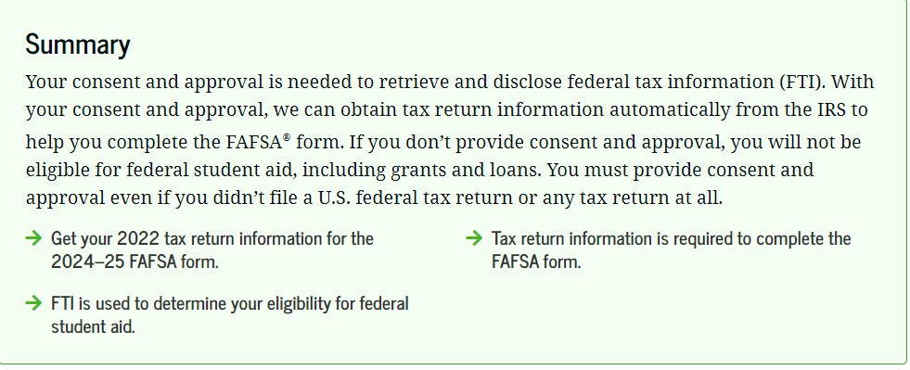
Refusal to Provide Consent
Contributors are required to provide consent – refusal results in the student being deemed ineligible for federal and/or state financial aid
Manual entry is only permitted when tax status conflicts with marital status
Student Financial Aid Services
Notes:
6

Slide 13
Technical Issues
If you are experiencing technical issues, contact Federal Student Aid at 1-800-433-3243
You can also email and chat with FSA staff https://studentaid.gov/help-center/contact
Email NJIT Student Financial Aid Services with technical issues (fafsa-group@njit.edu) with the subject line: 2024-2025 FAFSA Filing
Student Financial Aid Services
Notes:
2

Slide 14
Next Steps
Universities and colleges expect to start receiving student’s FAFSAs in mid-March
After FAFSAs are received, Student Financial Aid Services will start notifying students about their aid eligibility in early April
In the meantime, students can fill out a form and receive an Estimated Financial Aid Eligibility Summary
Monitor your personal and NJIT emails to receive communication about the form, your financial aid eligibility, and your aid offers
Student Financial Aid Services
Notes:
2

Slide 15
Non-Federal Assistance
New Jersey Aid
- Tuition Aid Grant, Garden State Guarantee, Educational
Opportunity Fund
To Do
- Create your NJFAMS account (njfams.hesaa.org) for state aid
- Log in to NJFAMS: Check To-Do List, Award and Eligibility
- NJ Dreamers: Complete NJ Alternative Financial Aid Application
https://hesaa.org/Pages/NJAlternativeApplication.aspx
Merit Based Scholarships
External Scholarships
Student Financial Aid Services
Notes:
2

Slide 16
Resources
Scholarship Universe: NJIT students can look for scholarship opportunities through this portal https://www.njit.edu/financialaid/scholarship-universe-njit
Experience Day: Meet with Financial Aid and Admissions on Sunday, April 7, 2024 - njit.edu/experience
FAFSA: https://studentaid.gov/h/apply-for-aid/fafsa
How Aid Works: https://studentaid.gov/h/understand-aid/how-aid-works
Federal Student Aid Estimator:
https://studentaid.gov/aid-estimator/
Student Financial Aid Services
Notes:
2

Slide 17

2024-2025 FAFSA Prototype
Review the FAFSA Prototype: https://fsapartners.ed.gov/fafsa-prototype/2425
  Access Code: prototype2425
Student scenario
Parent scenario
Not a final FAFSA Demo!
Student Financial Aid Services
Notes:
6

Slide 18

Important Information
Visit SFAS 2024-2025 FAFSA page at https://www.njit.edu/financialaid/2024-2025-fafsa
2024-2025 FAFSA FAQs Videos https://www.youtube.com/playlist?list=PLtr3wy4M_CJ2Hrd0UwCAWJOgOPu8l_ZLf
Follow Federal Student Aid on:
- X (formerly Twitter)
- Instagram
- Facebook
- YouTube
U. S. Department of Education & NJIT Financial Aid Emails
Student Financial Aid Services
Notes:
6

Slide 19
Contact Student Financial Aid Services
Phone
Email
(973) 596-3479
finaid@njit.edu
Fax
Meeting
(973) 596-2460
https://connect.njit.edu/portal/SFAS-events
Student Financial Aid Services
Notes:
6

Slide 20
Contact Admissions
(973) 596-3300
(973) 596-3461
Email
admissions@njit.edu
Student Financial Aid Services
Notes:
6

Slide 21

Questions?
Student Financial Aid Services

