Slide 1

New jersey institute of technology NAVIGATION TRAINING
COGNOS ANALYTICS
Provided by: Financial Systems & Innovation Date: August 30 & September 1, 2020

Slide 2

What is Cognos analytics
Cognos Analytics 11 is an upgrade to Cognos BI version 10 and has a brand-new user interface with improved user experience.
The new and improved business intelligence solution makes it easier to visualize data and share information across our organization to foster data-driven decisions.
New Element Names
Simple Navigation
IBM enhanced support with sample data and training videos (sign-up for IBM community)

Slide 3

NEW ELEMENT NAMES Analytics 11 vs Business intelligence 10
Cognos Analytics 11 | Cognos BI 10
Portal | Cognos connection
My Content | My Folder
Team Content | Public Folders
Report (Merged Together) | Report Studio Cognos Workspace Advanced Viewer
Dashboard | Cognos Workspace

Slide 4

Navigation terminology
Home Page | Description
Switcher | Switch from different modules on the same page
Canvas | Work area which include recent reports and quick reference guide
Navigation Panel | Easy access to search, my content, & team content
File Drop Zone | Customize report by uploading your data
Settings | Notifications, Schedules, Preferences, Sign-Out, IBM Documentation, Learning Center, Community

Slide 5
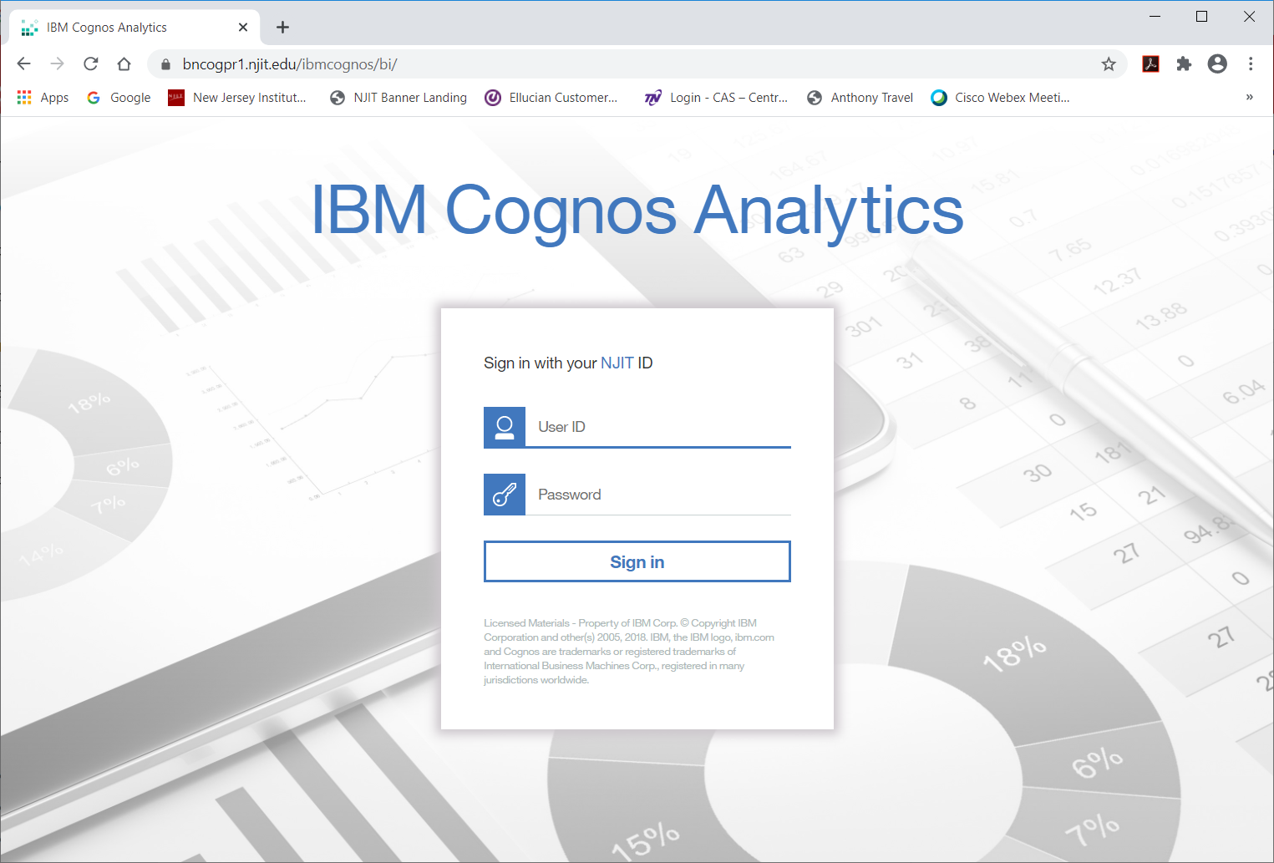

HOW TO LOG-IN
https://bncogpr1.njit.edu/ibmcognos/bi/
Your UCID
Your computer password

Slide 6
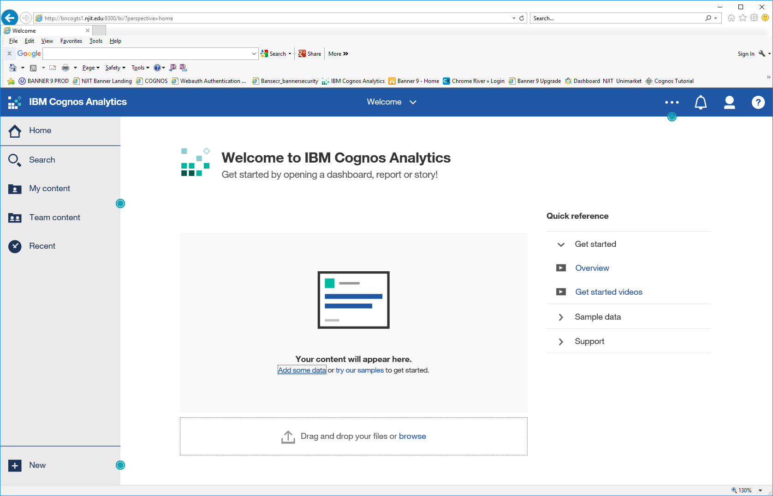
Switcher
Settings
Canvas (workspace)
Navigation Panel
File Drop Zone

Slide 7
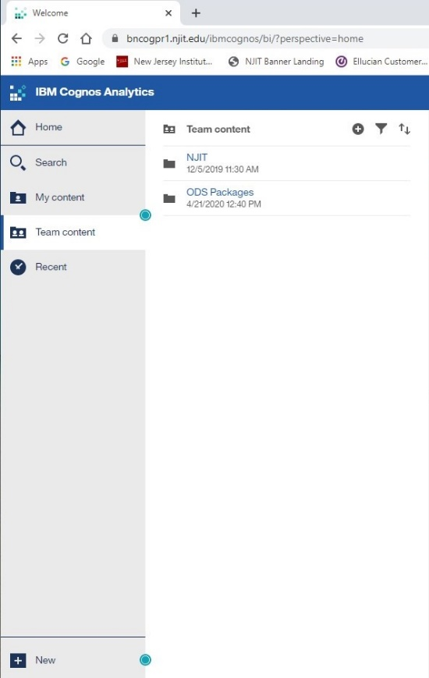
Navigation panel
Search – new dynamic feature to search for reports/others using key words
My/Team Content – files saved in your personal folder and/or shared with departments
Recent – Displays most common used reports
New – Create reports, dashboard, story, data module, other and upload files

Slide 8

NAVIGATION TRAINING
Simple Navigation
No need to go to different screens to change package
Dynamic description selection identifying icons as mouse pointer lands on item
Search feature, just start typing
Utilizes ellipses and icons
Enhanced IBM customer business solution through their portal
Next training – Basic report creation

Slide 9

MAKE SURE YOU….
VISIT THE IBM TO REGISTER YOUR TO ACCESS SAMPLES AND VIDEOS (you can find the link in COGNOS)
LOG IN TO THE NEW COGNOS ANALYTICS PLATFORM AND OPEN YOUR FILES
COMPARE YOUR REPORTS IN CA11 VS CBI10 BEFORE OCTOBER 10TH
VISIT OUR COGNOS ANALYTICS WEBSITE UNDER FSI FOR MORE INFORMATION

